Slide 1

App Schedules and Logistics Overview

Slide 2
From: AdvocacyDay <advocacyday@advocacyassociates.com>
Date: November 4, 2024 at 11:10:00 AM EST
To: Kaytee Yakacki <>
Subject: Schedule for Sample Lobby Day
﻿
Hello Kaytee Yakacki,
You can access your meeting schedule for Sample Lobby Day on our free "AdvocacyDay" app, available in the App Store for Apple devices and in the Google Play Store for Android devices.
If you already have the AdvocacyDay App downloaded to your device, it is critical you have the most up-to-date version downloaded before logging in.
The directions to access are as follows:
In your device's app store, search for "AdvocacyDay" (all one word) and download it.
On the login screen, enter the following email address: your email address
You will be emailed a 6-digit code to enter on the next screen.
If you are a part of multiple organizations in our app, you will be prompted to choose your organization here. For Sample Lobby Day, please choose O. If you are only a part of one organization, you will be brought directly to your meeting schedule page.
There is a Support button on the login screen if you have any issues, or you can contact support here: advocacyday.net/testorg/support
If you already have the AdvocacyDay App downloaded to your device, please make sure it is up-to-date before logging in.
If you are having trouble finding "AdvocacyDay" in your app store, please click on the appropriate link below:
Apple App Store: https://apps.apple.com/us/app/advocacyday/id798728613
Google Play Store: https://play.google.com/store/apps/details?id=com.advocacyday.android&hl=en_US&gl=US
As a web-based backup, you can also view your schedule for Sample Lobby Day here: advocacyday.net/testorg. The login process is the same.
Thank you,
Advocacy Associates
Downloading the App
You will receive an automated email from Advocacy Associates on a to-be-determined date by your organization
Check your SPAM/JUNK folder if you think you did not receive the email
  Verify with your organization on the date this email was/will be sent

Slide 3
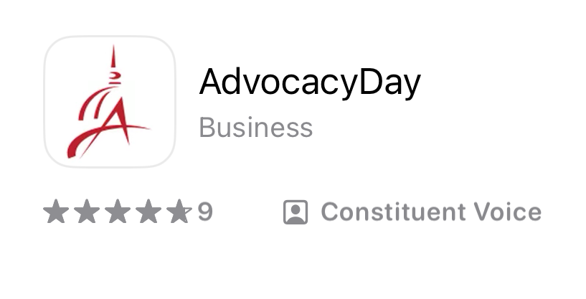
From: AdvocacyDay <advocacyday@advocacyassociates.com>
Date: November 4, 2024 at 11:10:00 AM EST
To: Kaytee Yakacki <>
Subject: Schedule for Sample Lobby Day
﻿
Hello Kaytee Yakacki,
You can access your meeting schedule for Sample Lobby Day on our free "AdvocacyDay" app, available in the App Store for Apple devices and in the Google Play Store for Android devices.
If you already have the AdvocacyDay App downloaded to your device, it is critical you have the most up-to-date version downloaded before logging in.
The directions to access are as follows:
In your device's app store, search for "AdvocacyDay" (all one word) and download it.
On the login screen, enter the following email address: your email address
You will be emailed a 6 digit code to enter on the next screen.
If you are a part of multiple organizations in our app, you will be prompted to choose your organization here. For Sample Lobby Day, please choose O. If you are only a part of one organization, you will be brought directly to your meeting schedule page.
There is a Support button on the login screen if you have any issues, or you can contact support here: advocacyday.net/testorg/support
If you already have the AdvocacyDay App downloaded to your device, please make sure it is up-to-date before logging in.
If you are having trouble finding "AdvocacyDay" in your app store, please click on the appropriate link below:
Apple App Store: https://apps.apple.com/us/app/advocacyday/id798728613
Google Play Store: https://play.google.com/store/apps/details?id=com.advocacyday.android&hl=en_US&gl=US
As a web-based backup, you can also view your schedule for Sample Lobby Day here: advocacyday.net/testorg. The login process is the same.
Thank you,
Advocacy Associates
Downloading the App
You will receive an automated email from Advocacy Associates on a to-be-determined date by your organization
Check your SPAM/JUNK folder if you think you did not receive the email
  Verify with your organization on the date this email was/will be sent
Follow the instructions to download the app

Slide 4
From: AdvocacyDay <advocacyday@advocacyassociates.com>
Date: November 4, 2024 at 11:10:00 AM EST
To: Kaytee Yakacki <>
Subject: Schedule for Sample Lobby Day
﻿
Hello Kaytee Yakacki,
You can access your meeting schedule for Sample Lobby Day on our free "AdvocacyDay" app, available in the App Store for Apple devices and in the Google Play Store for Android devices.
If you already have the AdvocacyDay App downloaded to your device, it is critical you have the most up-to-date version downloaded before logging in.
The directions to access are as follows:
In your device's app store, search for "AdvocacyDay" (all one word) and download it.
On the login screen, enter the following email address: your email address
You will be emailed a 6 digit code to enter on the next screen.
If you are a part of multiple organizations in our app, you will be prompted to choose your organization here. For Sample Lobby Day, please choose O. If you are only a part of one organization, you will be brought directly to your meeting schedule page.
There is a Support button on the login screen if you have any issues, or you can contact support here: advocacyday.net/testorg/support
If you already have the AdvocacyDay App downloaded to your device, please make sure it is up-to-date before logging in.
If you are having trouble finding "AdvocacyDay" in your app store, please click on the appropriate link below:
Apple App Store: https://apps.apple.com/us/app/advocacyday/id798728613
Google Play Store: https://play.google.com/store/apps/details?id=com.advocacyday.android&hl=en_US&gl=US
As a web-based backup, you can also view your schedule for Sample Lobby Day here: advocacyday.net/testorg. The login process is the same.
Thank you,
Advocacy Associates
Downloading the App
You will receive an automated email from Advocacy Associates on a to-be-determined date by your organization
Check your SPAM/JUNK folder if you think you did not receive the email
  Verify with your organization on the date schedules were/will be sent
Follow the instructions to download the app
Contact us for any technical support

Slide 5
From: AdvocacyDay <advocacyday@advocacyassociates.com>
Date: November 4, 2024 at 11:10:00 AM EST
To: Kaytee Yakacki <>
Subject: Schedule for Sample Lobby Day
﻿
Hello Kaytee Yakacki,
You can access your meeting schedule for Sample Lobby Day on our free "AdvocacyDay" app, available in the App Store for Apple devices and in the Google Play Store for Android devices.
If you already have the AdvocacyDay App downloaded to your device, it is critical you have the most up-to-date version downloaded before logging in.
The directions to access are as follows:
In your device's app store, search for "AdvocacyDay" (all one word) and download it.
On the login screen, enter the following email address: your email address
You will be emailed a 6 digit code to enter on the next screen.
If you are a part of multiple organizations in our app, you will be prompted to choose your organization here. For Sample Lobby Day, please choose O. If you are only a part of one organization, you will be brought directly to your meeting schedule page.
There is a Support button on the login screen if you have any issues, or you can contact support here: advocacyday.net/testorg/support
If you already have the AdvocacyDay App downloaded to your device, please make sure it is up-to-date before logging in.
If you are having trouble finding "AdvocacyDay" in your app store, please click on the appropriate link below:
Apple App Store: https://apps.apple.com/us/app/advocacyday/id798728613
Google Play Store: https://play.google.com/store/apps/details?id=com.advocacyday.android&hl=en_US&gl=US
As a web-based backup, you can also view your schedule for Sample Lobby Day here: advocacyday.net/testorg. The login process is the same.
Thank you,
Advocacy Associates
Downloading the App
You will receive an automated email from Advocacy Associates on a to-be-determined date by your organization
Check your SPAM/JUNK folder if you think you did not receive the email
  Verify with your organization on the date schedules were/will be sent
Follow the instructions to download the app
Contact us for any technical support
Ensure you have the most up-to-date version

Slide 6
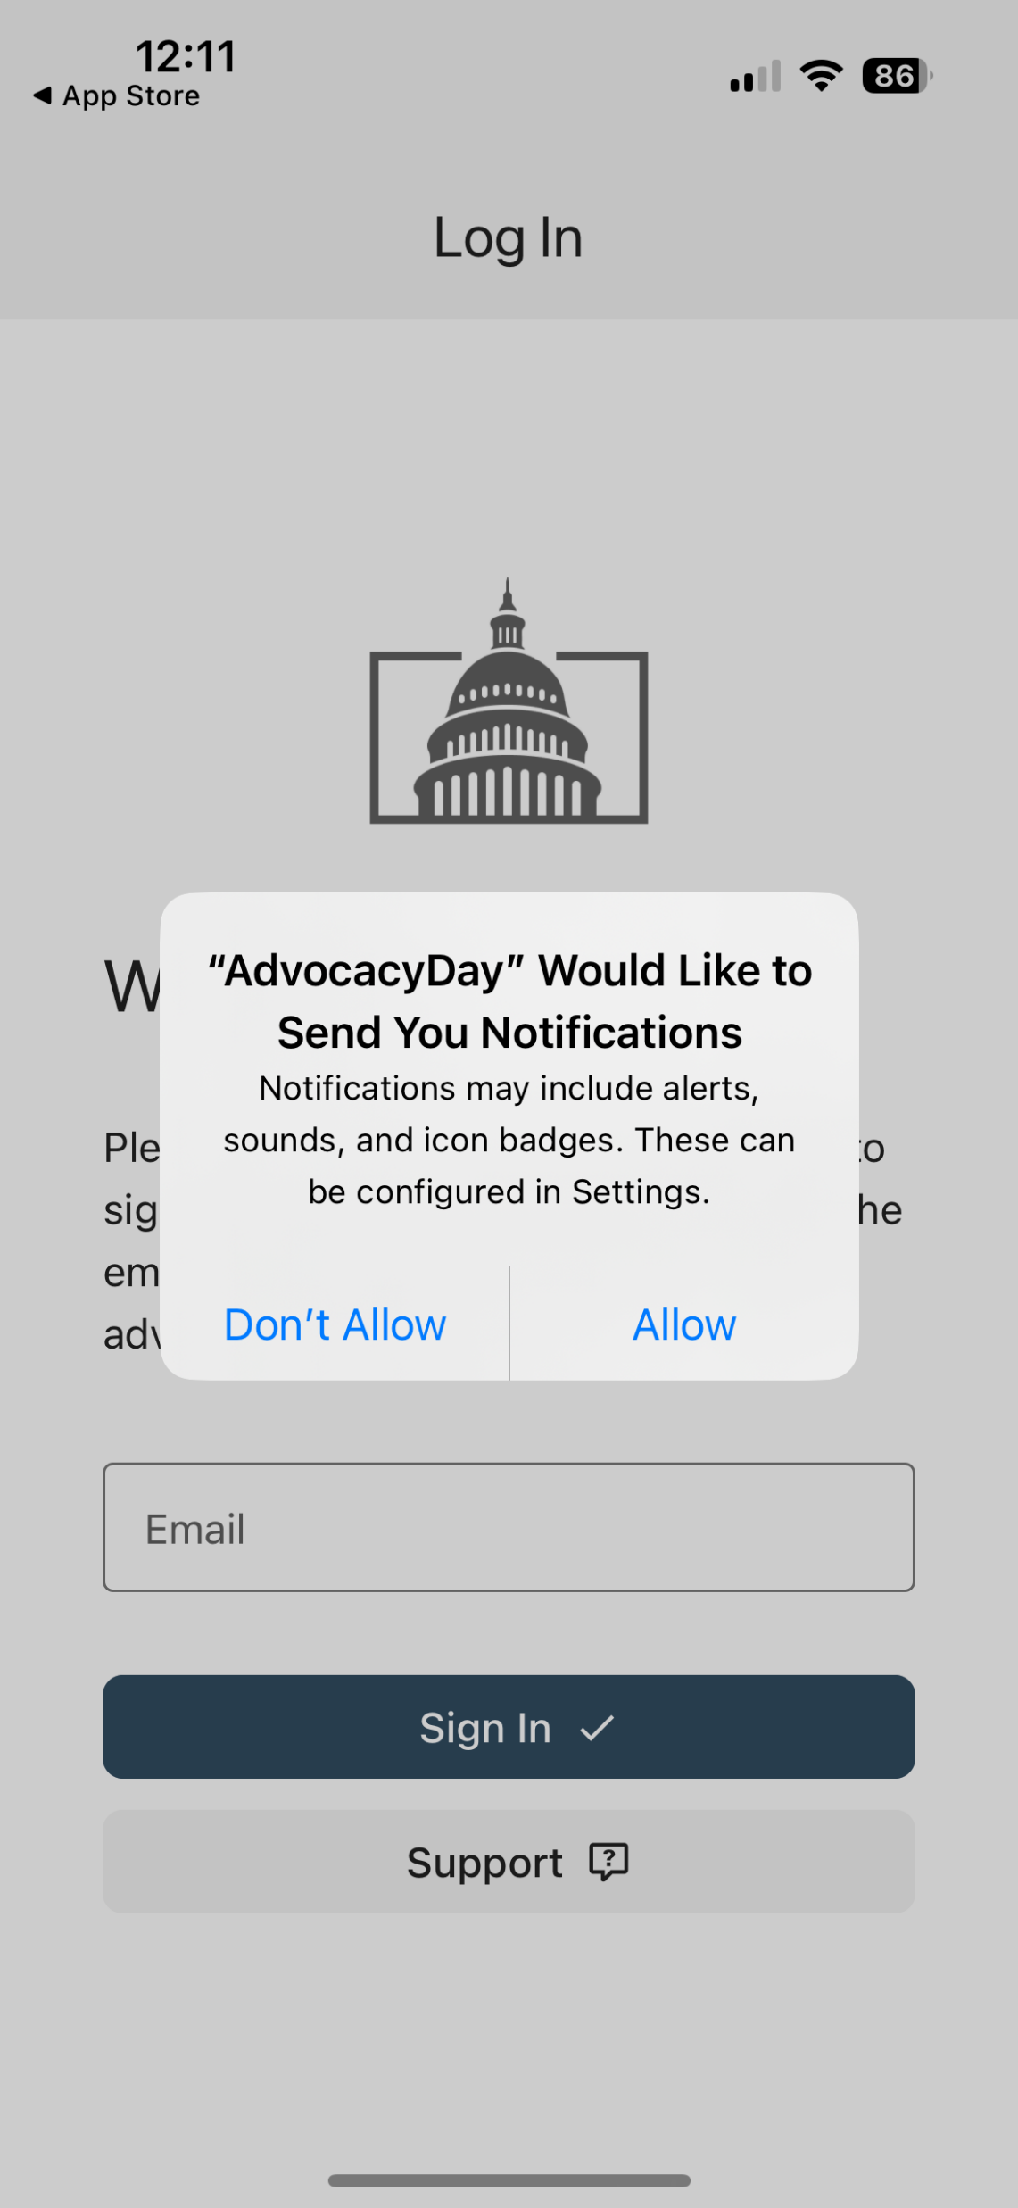
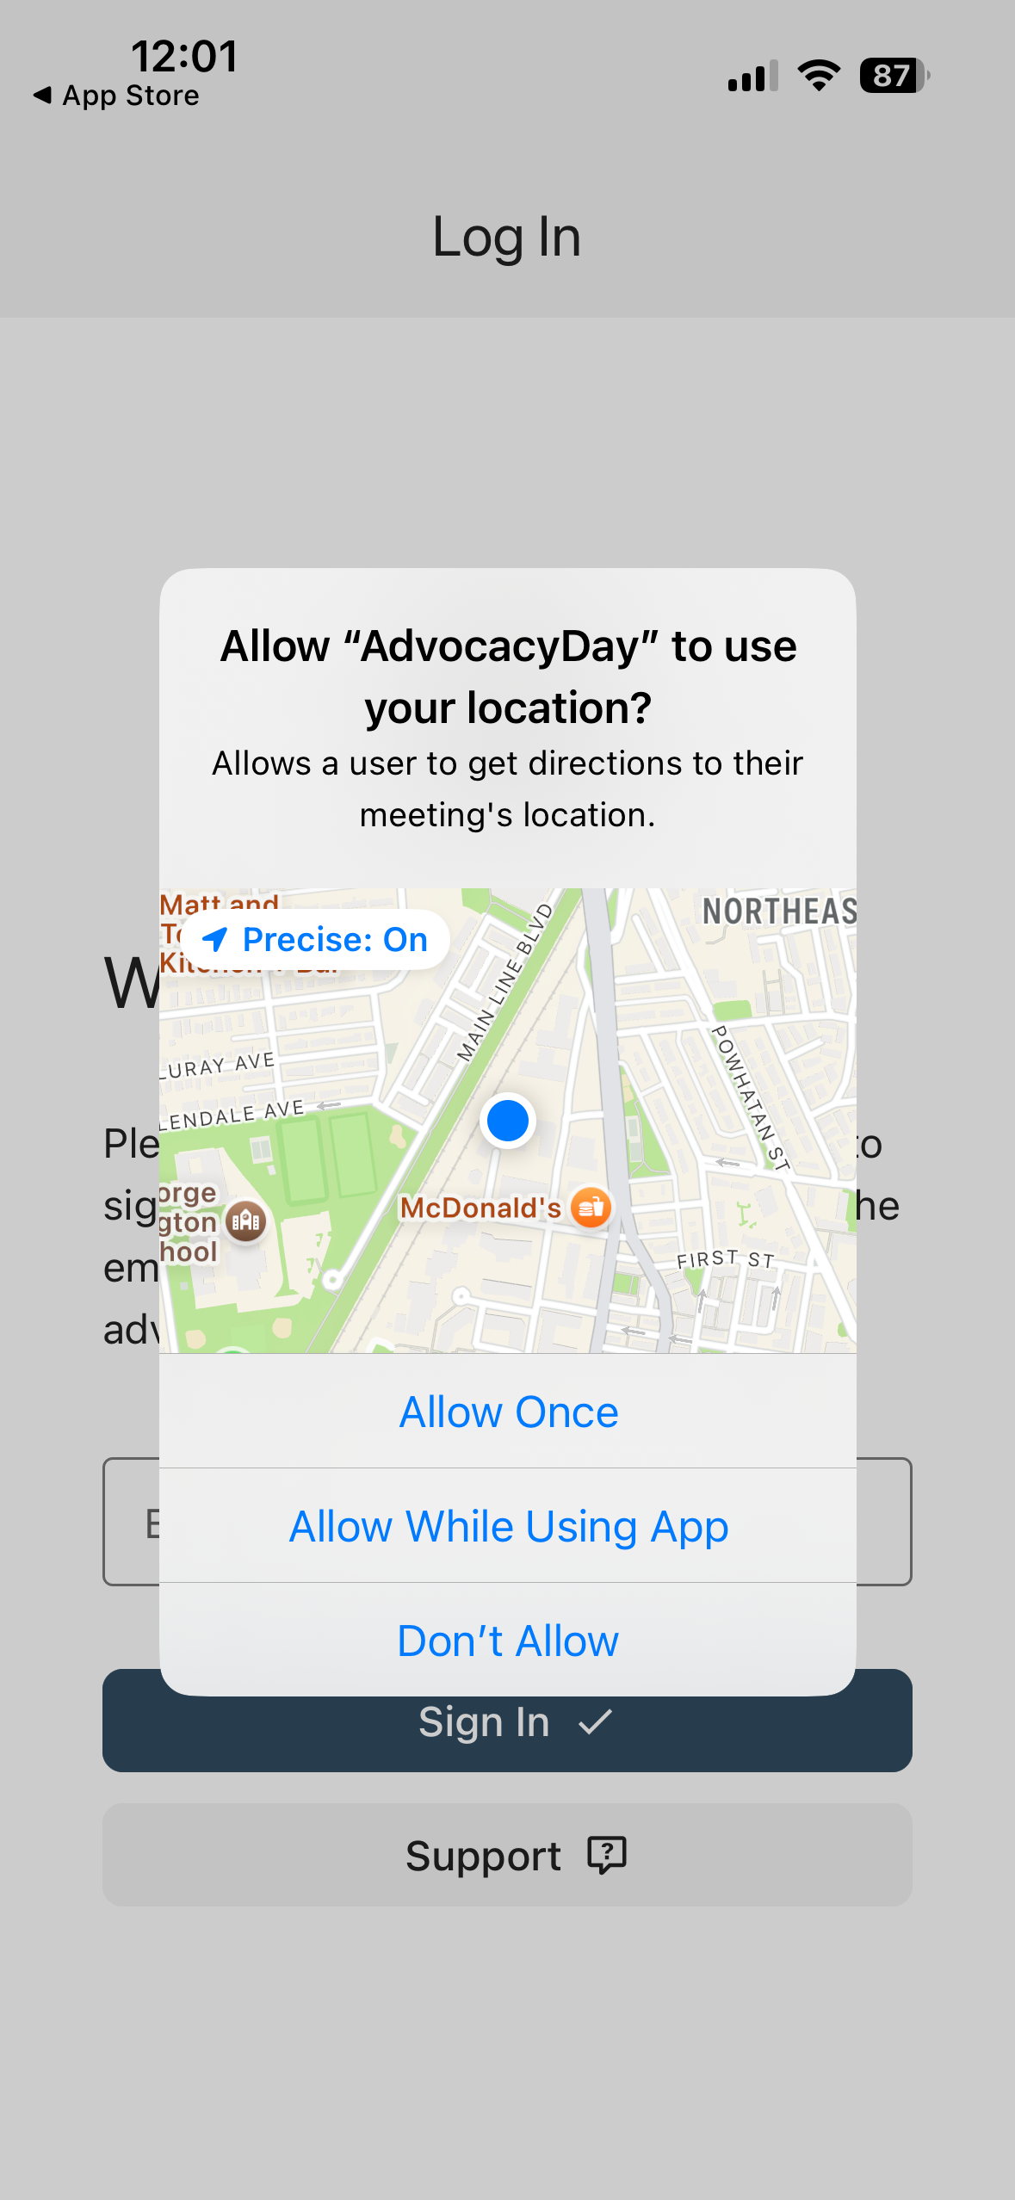
When Opening the App
Select “Allow” for notifications
Select “Allow While Using App” for location setting

Slide 7
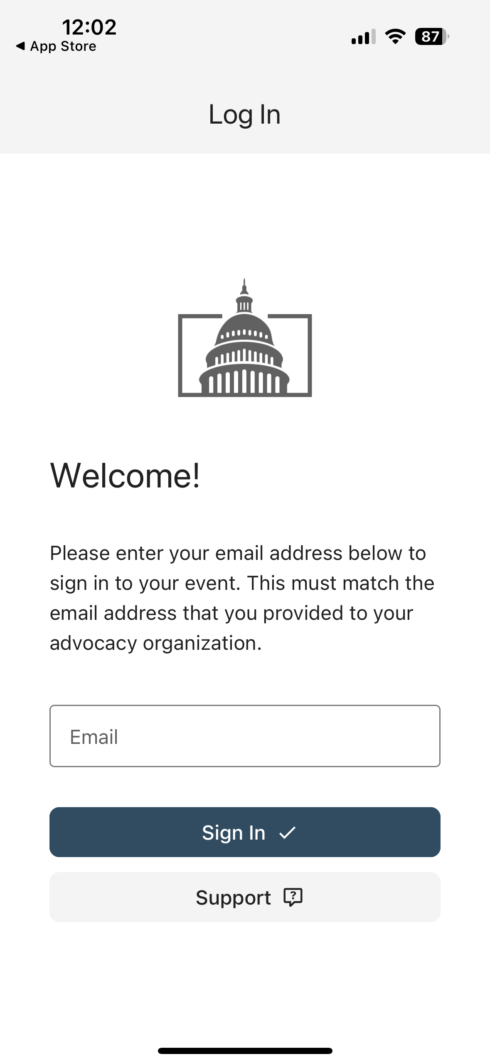
Logging In
Enter your email address that you registered for the event with, then tap “Sign In”

Slide 8
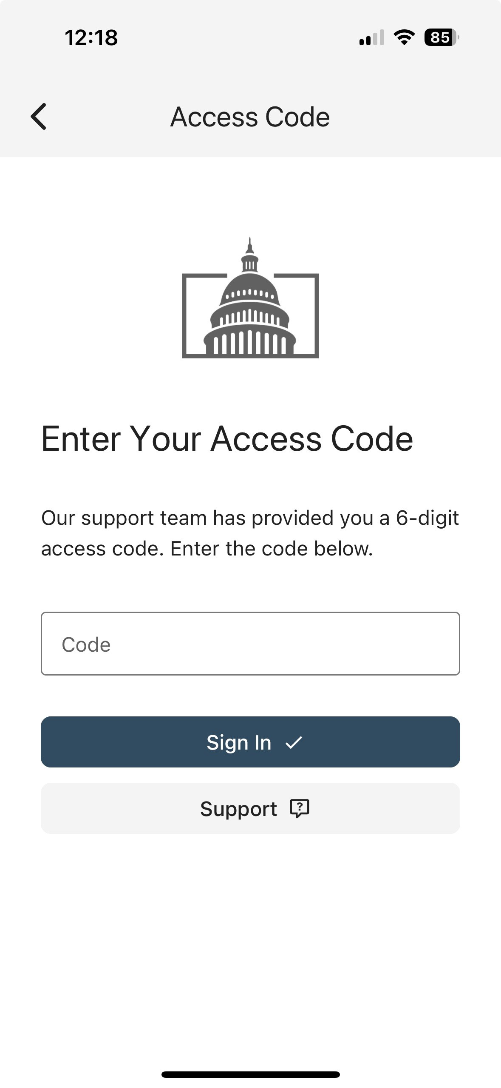
Logging In
Enter your email address that you registered for the event with, then tap “Sign In”
Check your email for a verification code. Input the code into the app and tap “Sign In”
From: AdvocacyDay <noreply@advocacyassociates.com>
Date: Thu, Oct 31, 2024 at 1:46 PM
Subject: Your access code is XXXXX
To: <youremailaddress>
Hello,
Your 6-digit AdvocacyDay access code is XXXXXX
It is valid for 15 minutes.

Slide 9
Logging In
Enter your email address that you registered for the event with, then tap “Sign In”
Check your email for a verification code. Input the code into the app and tap “Sign In”
If you don’t receive a code, or experience an error, tap “Support.” Our team will be reaching out to you shortly

Slide 10
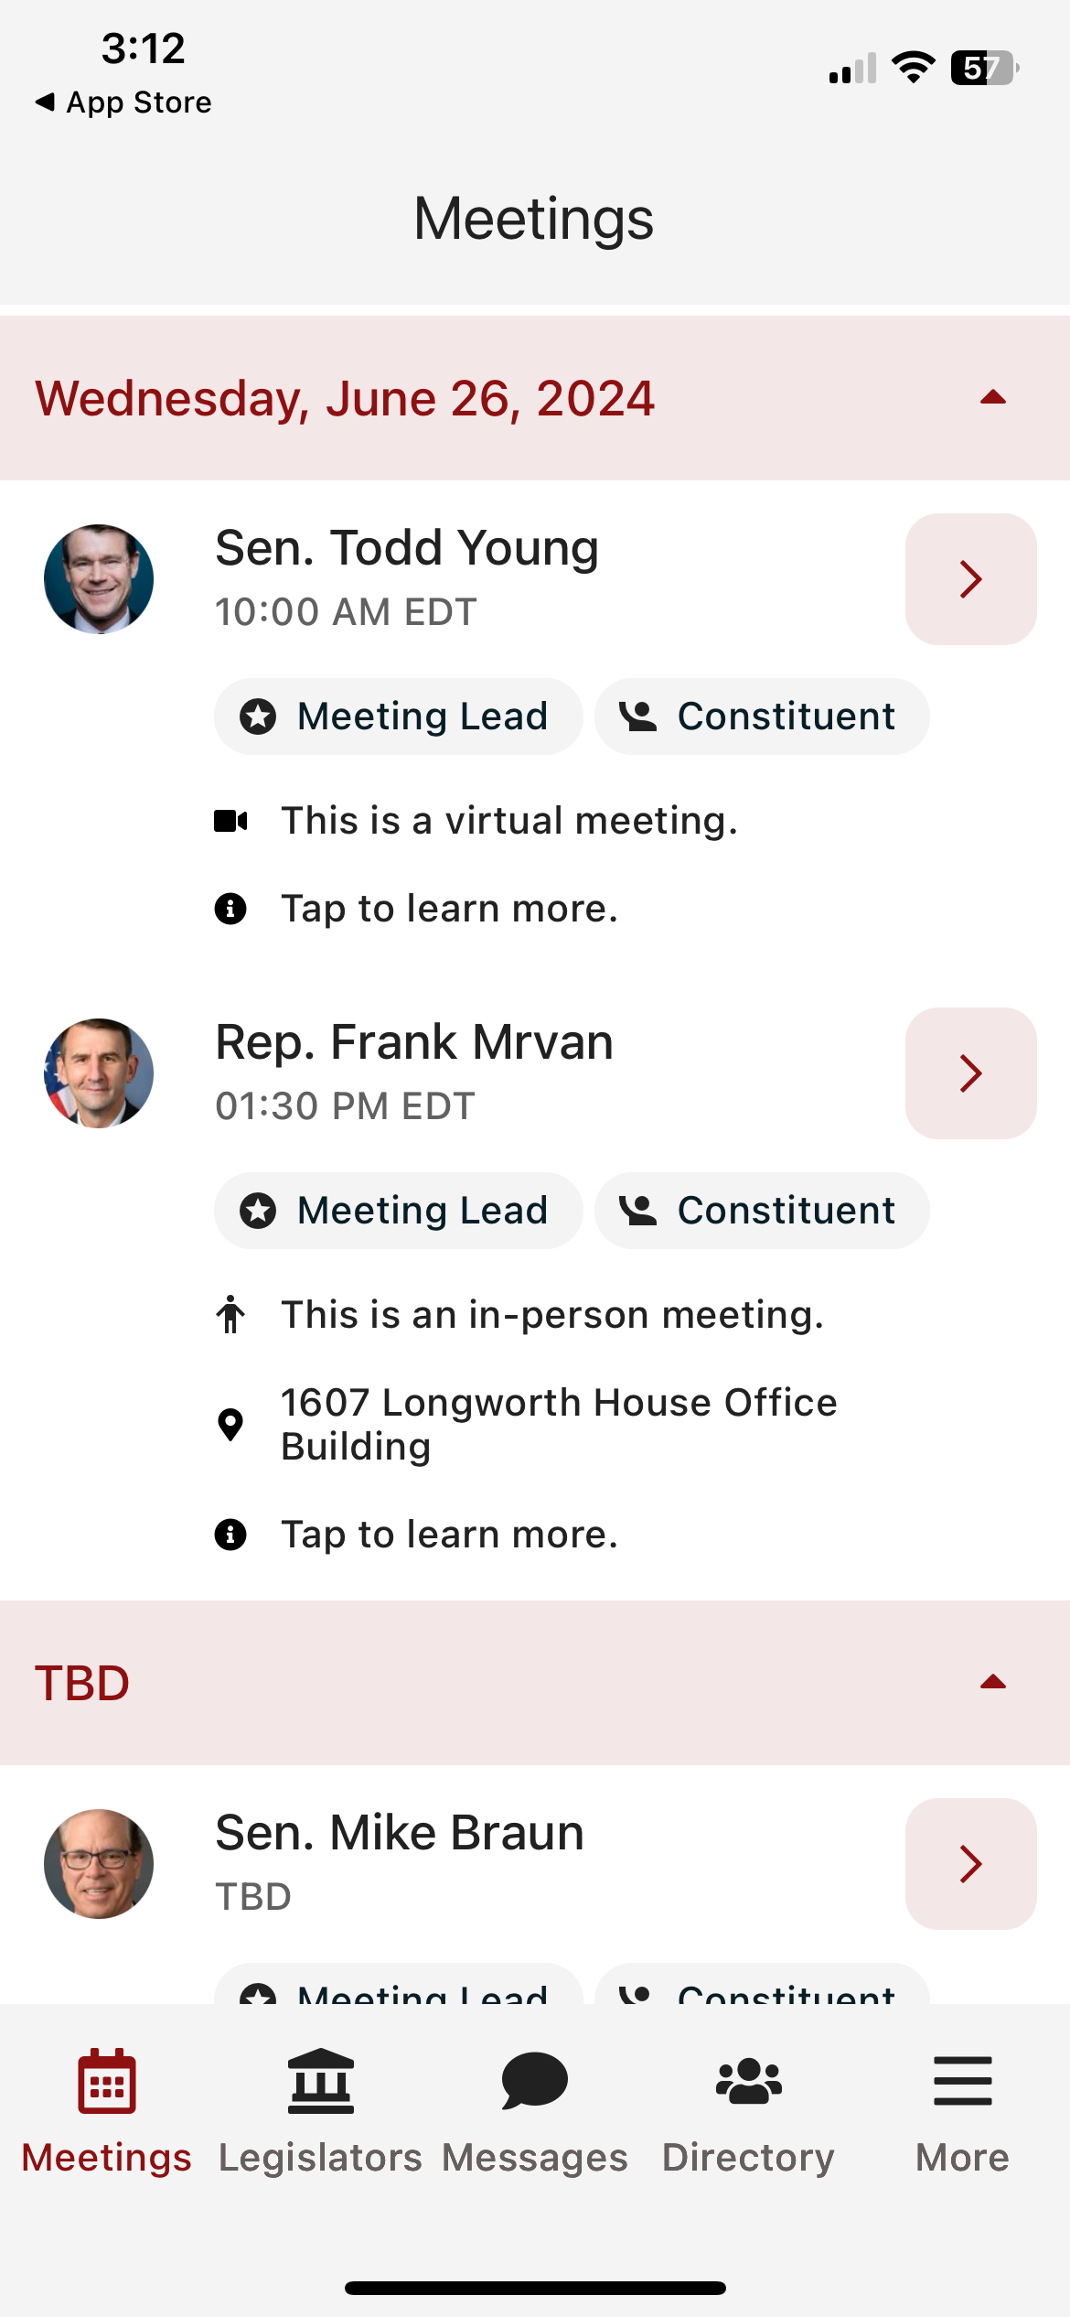
Main Schedule Page
Confirmed meetings display with a time, pending meetings display as TBD

Slide 11
Main Schedule Page
Confirmed meetings display with a time, pending meetings display as TBD
All times displayed in time zone you are located in

Slide 12
Main Schedule Page
Confirmed meetings display with a time, pending meetings display as TBD
All times displayed in time zone you are located in
Indicates in person or virtual
Badges indicating if you are a Constituent and/or Meeting Lead for that meeting

Slide 13
Main Schedule Page
Confirmed meetings display with a time, pending meetings display as TBD
All times displayed in time zone you are located in
Indicates in person or virtual
Badges indicating if you are a Constituent and/or Meeting Lead for that meeting
Tap anywhere on the meeting to learn more

Slide 14
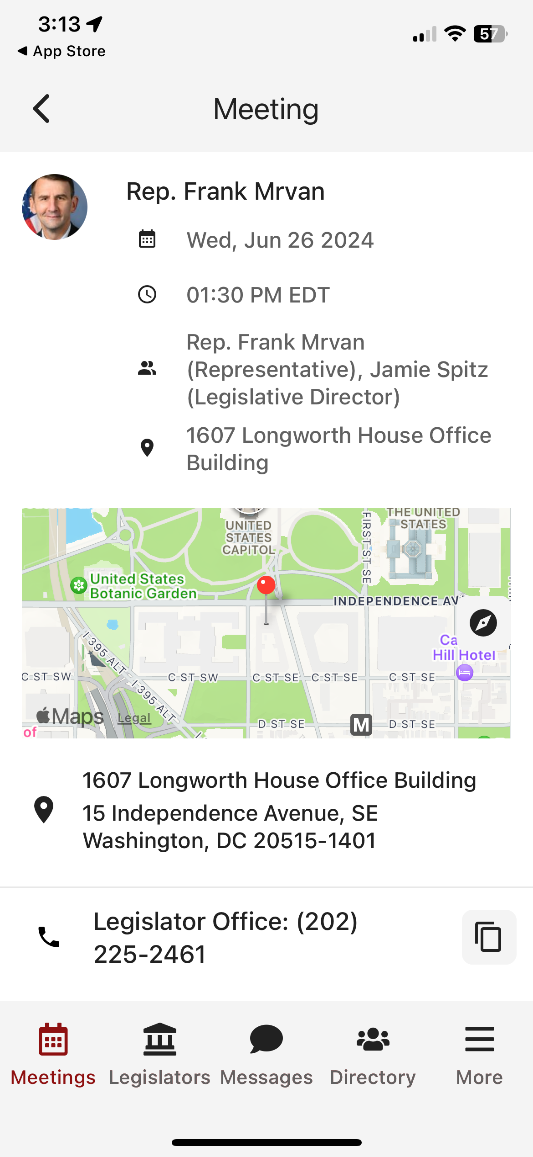
Date/Time/Meeting With/Location

Slide 15
Date/Time/Meeting With/Location
Tap on the map to get walking directions to the building

Slide 16
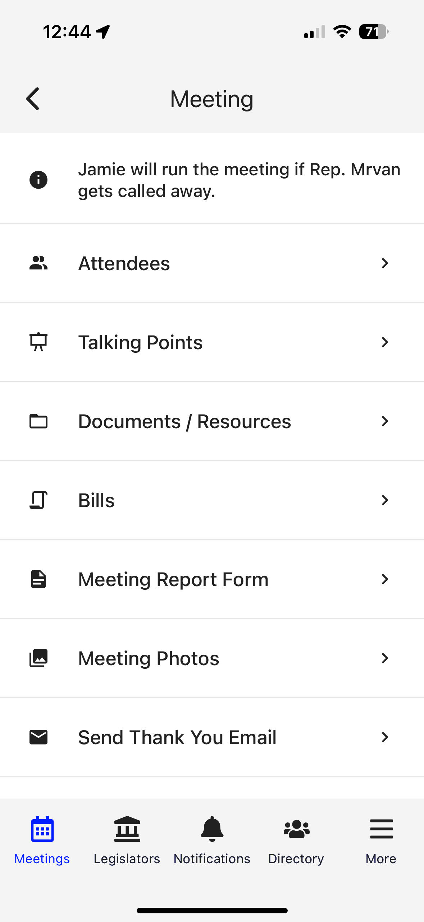
Date/Time/Meeting With/Location
Tap on the map to get walking directions to the building
Scroll down for any important information

Slide 17
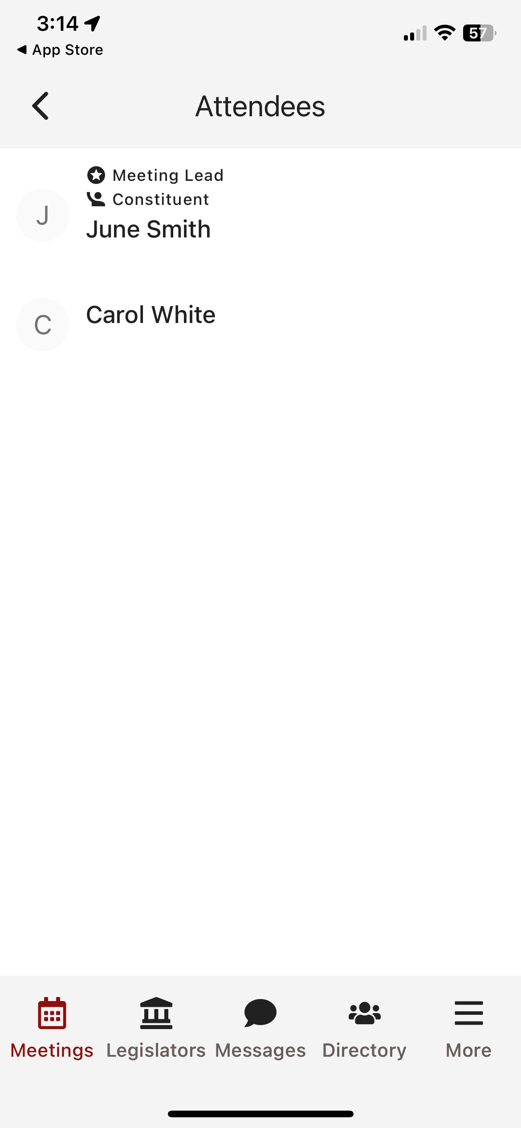
Date/Time/Meeting With/Location
Tap on the map to get walking directions to the building
Scroll down for any important information
Attendees in the meeting

Slide 18
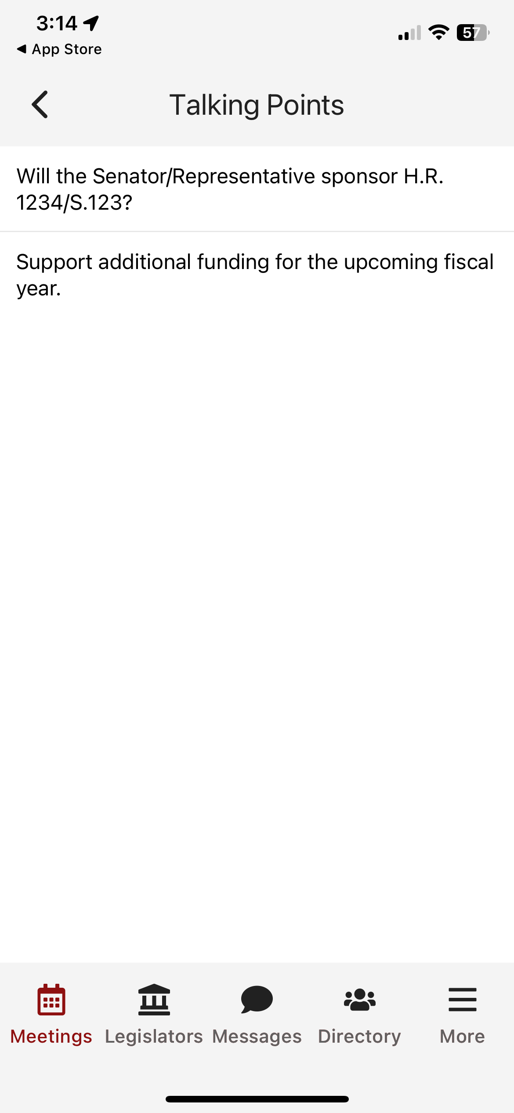
Date/Time/Meeting With/Location
Tap on the map to get walking directions to the building
Scroll down for any important information
Attendees in the meeting
Talking points

Slide 19
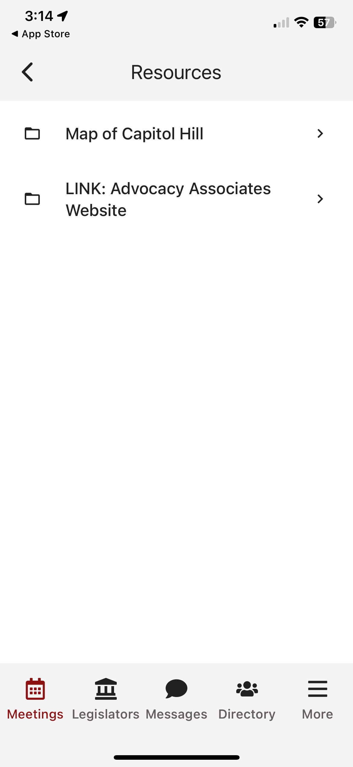
Date/Time/Meeting With/Location
Tap on the map to get walking directions to the building
Scroll down for any important information
Attendees in the meeting
Talking points
Documents and resources

Slide 20
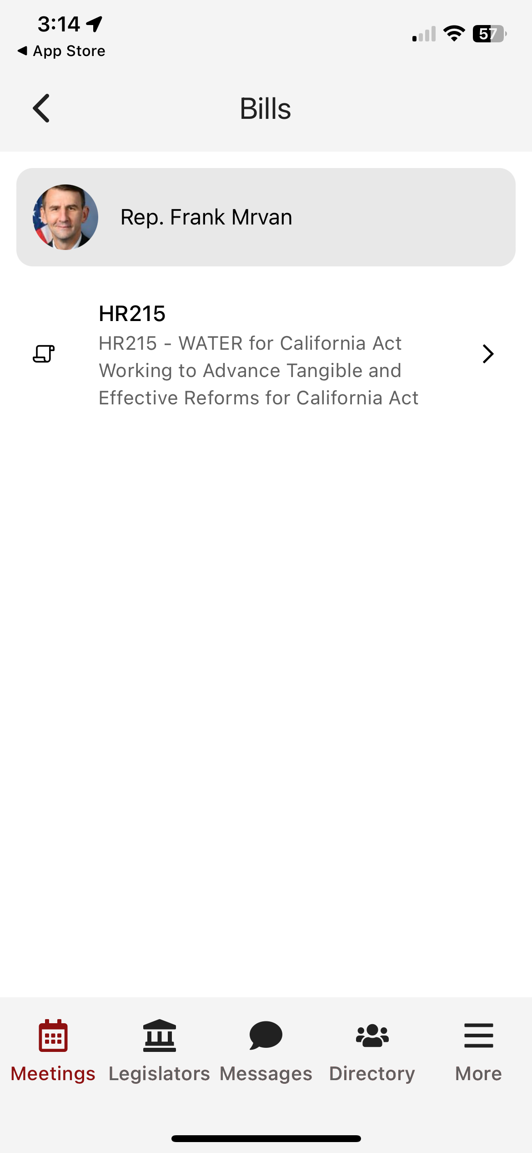
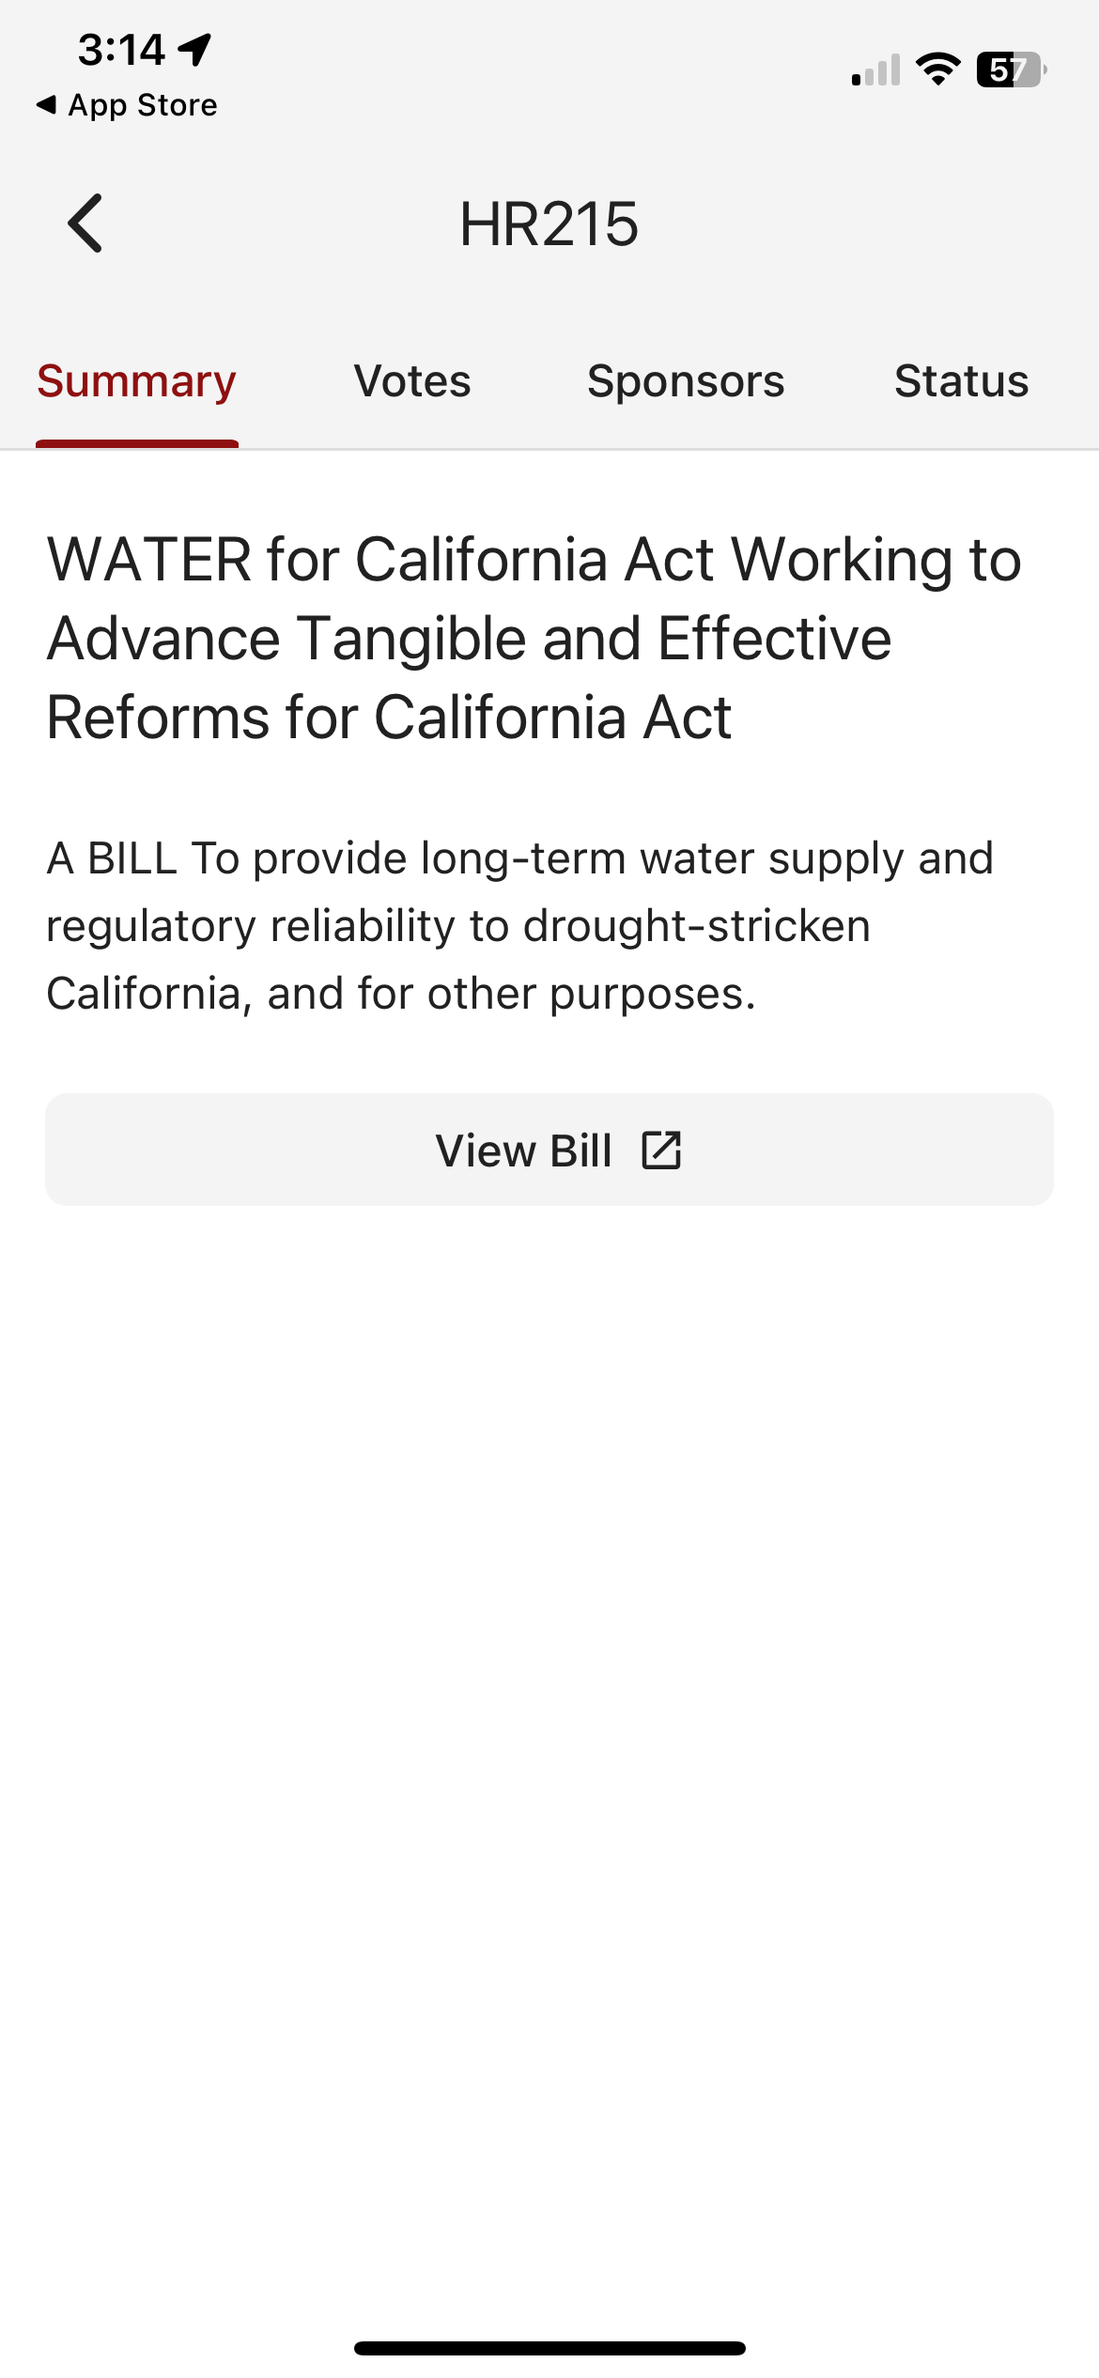
Date/Time/Meeting With/Location
Tap on the map to get walking directions to the building
Scroll down for any important information
Attendees in the meeting
Talking points
Documents and resources
Bills

Slide 21
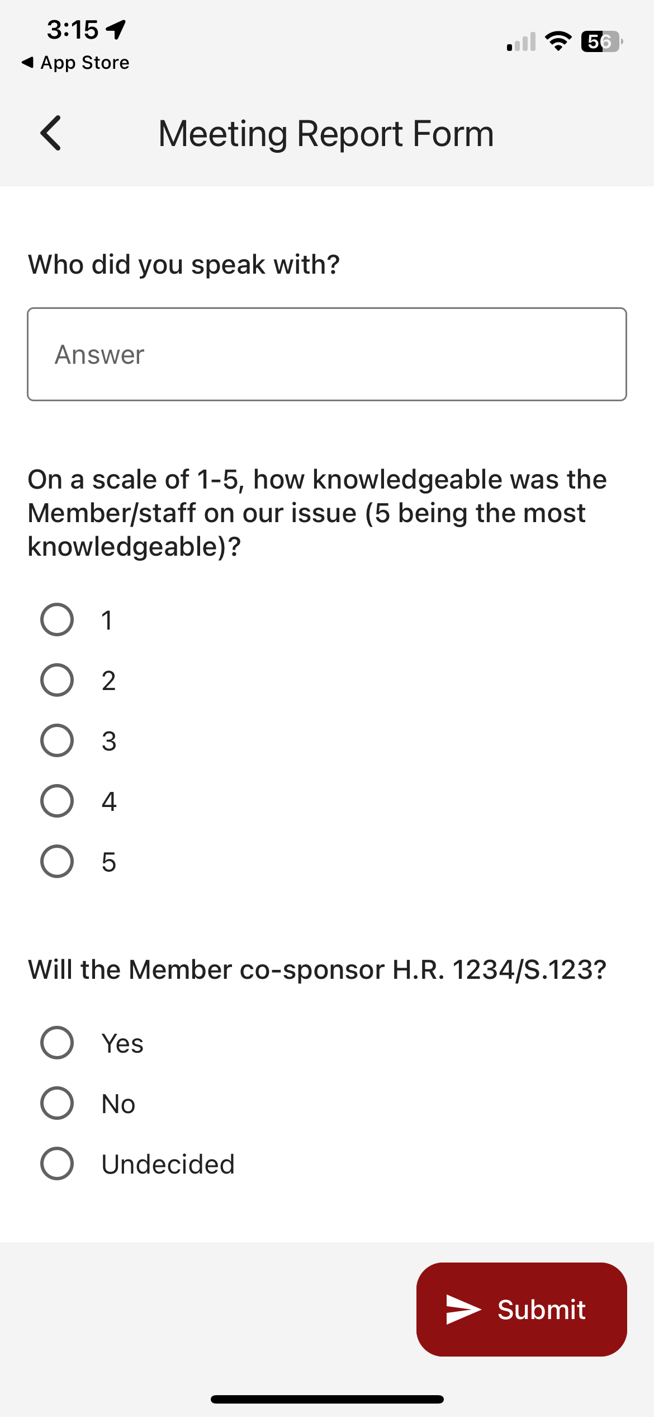
Date/Time/Meeting With/Location
Tap on the map to get walking directions to the building
Scroll down for any important information
Attendees in the meeting
Talking points
Documents and resources
Bills
Meeting report form

Slide 22
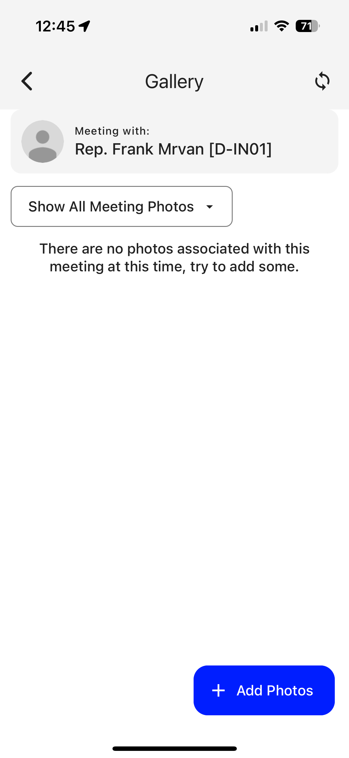
Date/Time/Meeting With/Location
Tap on the map to get walking directions to the building
Scroll down for any important information
Attendees in the meeting
Talking points
Documents and resources
Bills
Meeting report form
Take or add photos from your meeting

Slide 23
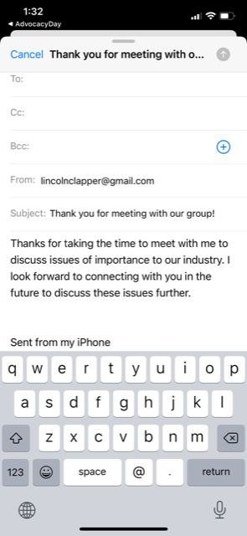
Thank you email

Slide 24
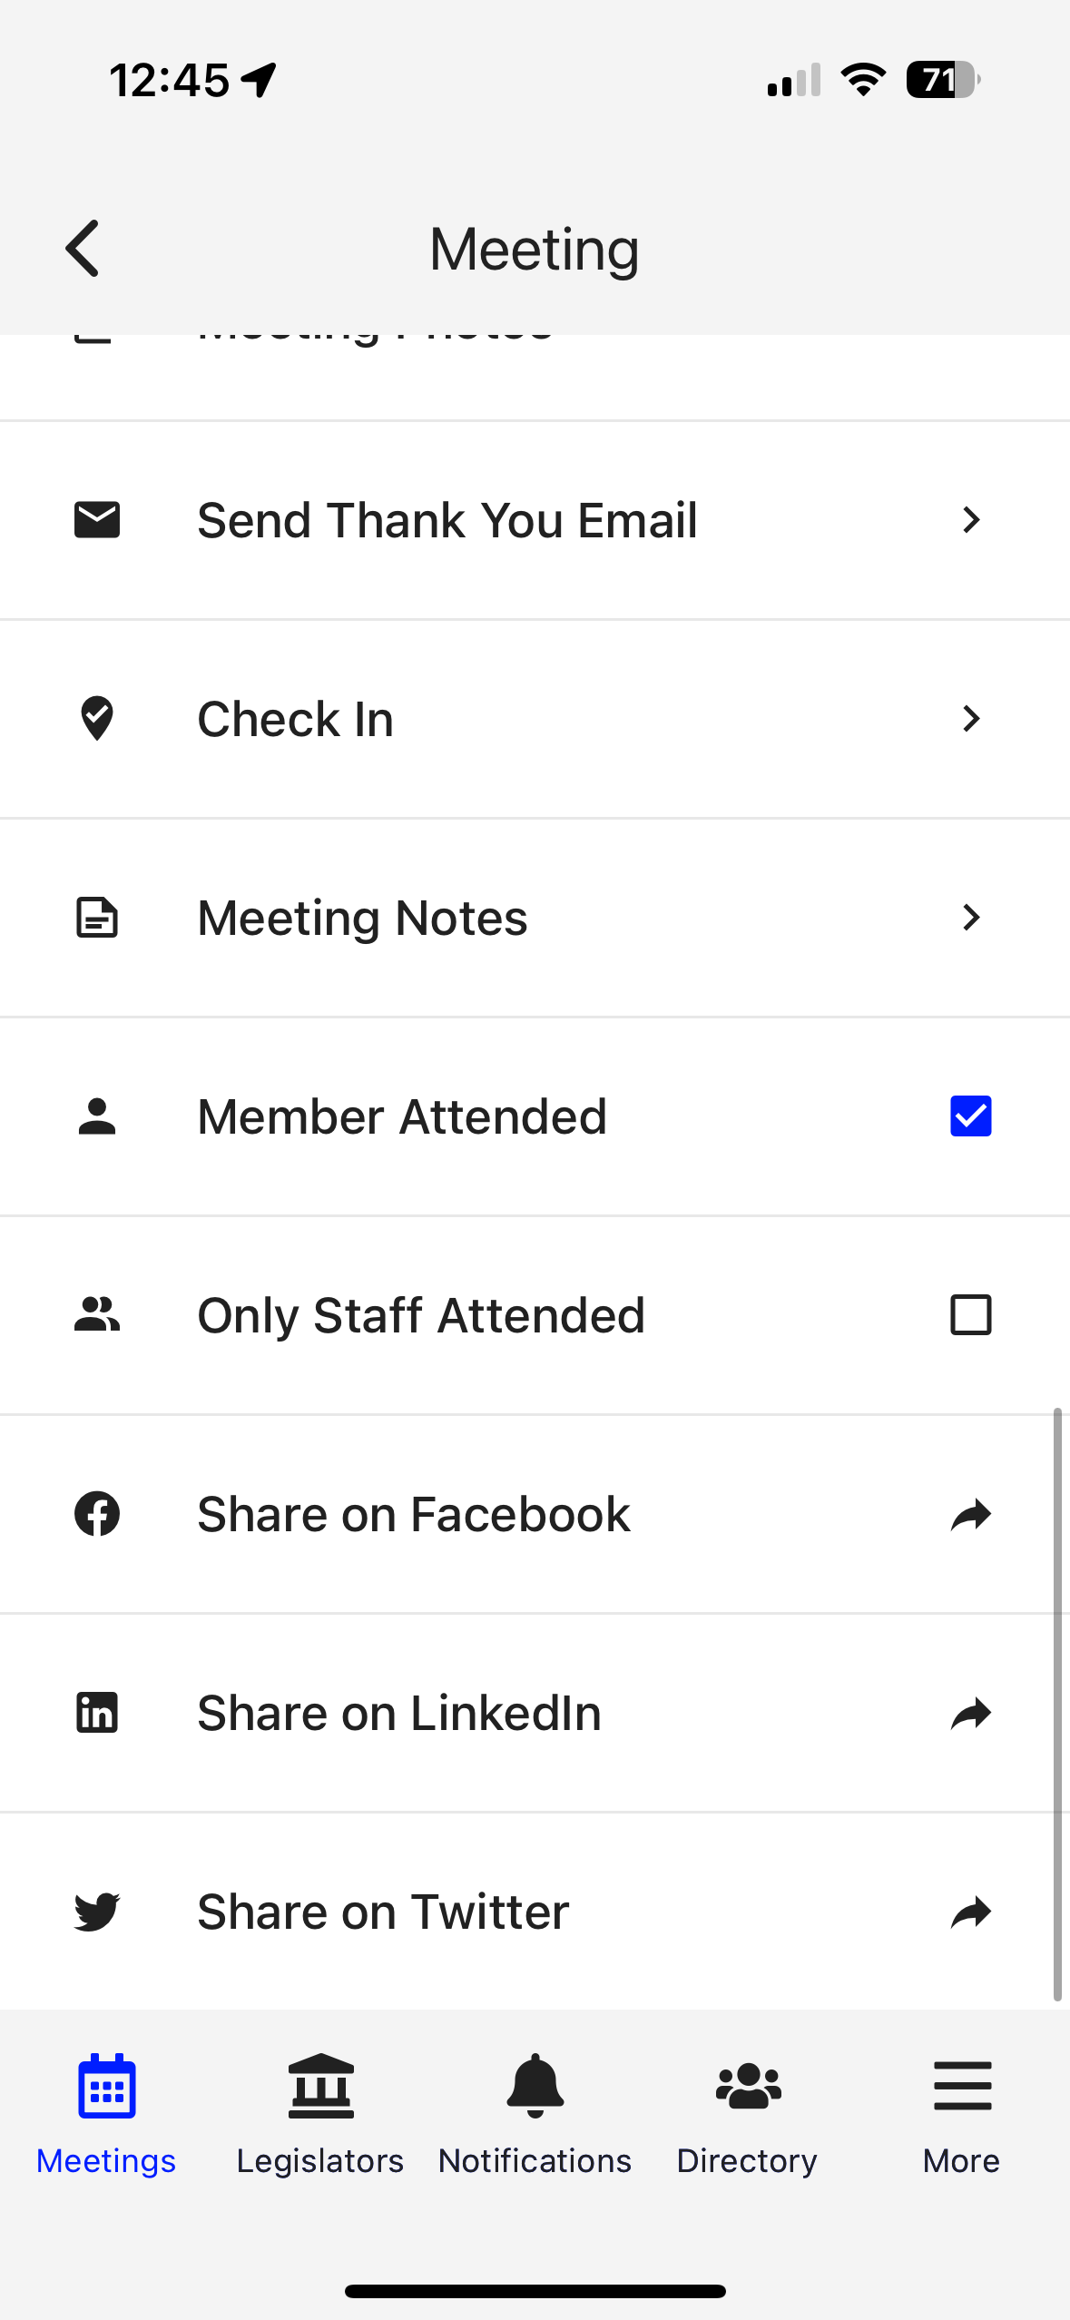
Thank you email
Check in to report attendance

Slide 25
Thank you email
Check in to report attendance
Take meeting notes

Slide 26
Thank you email
Check in to report attendance
Take meeting notes
Did the Member of Congress attend?

Slide 27
Thank you email
Check in to report attendance
Take meeting notes
Did the Member of Congress attend?
Create a social media post

Slide 28
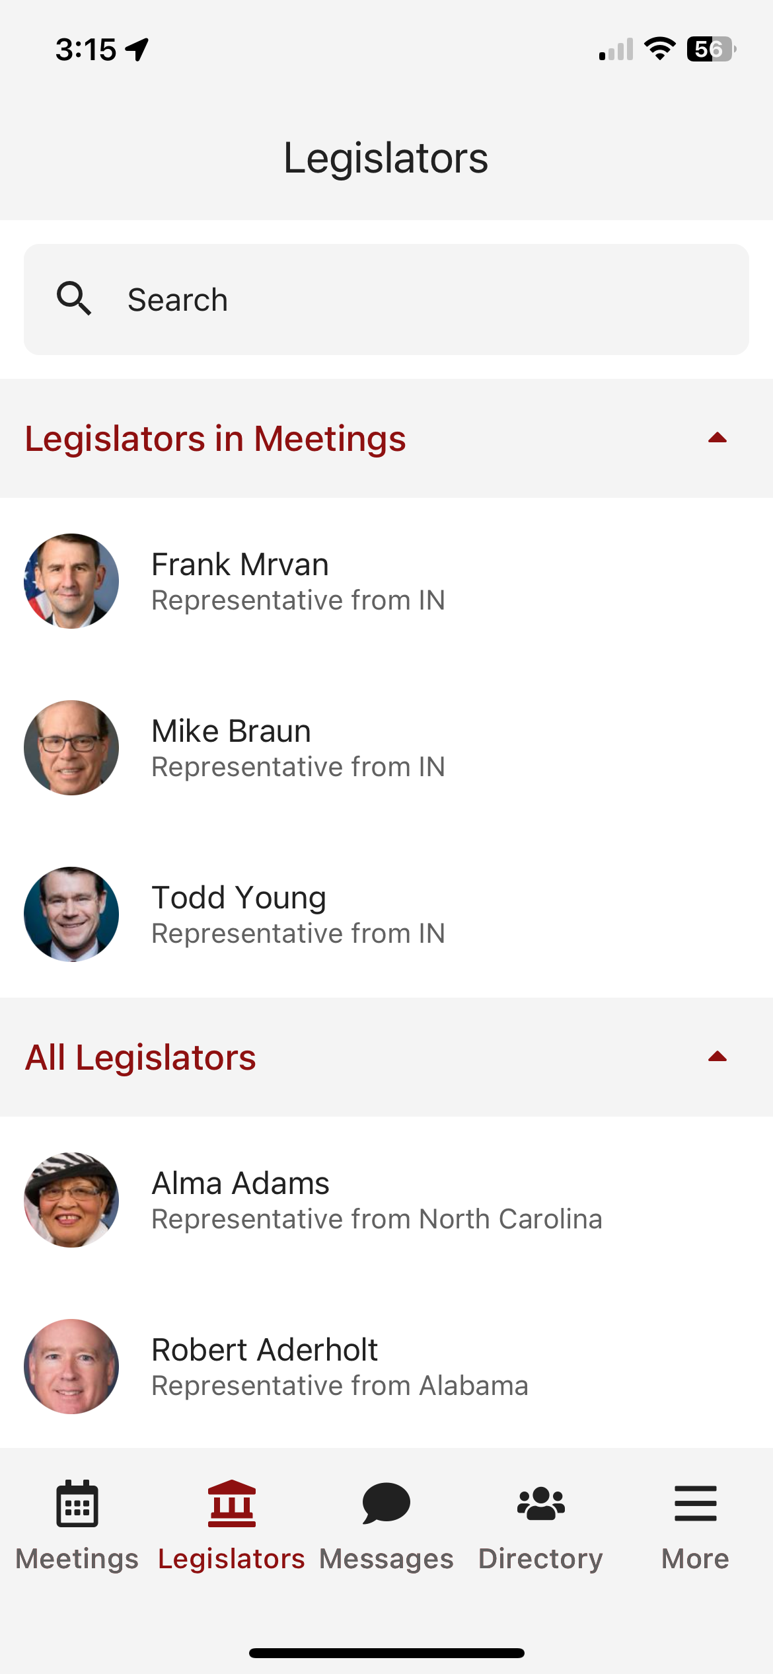
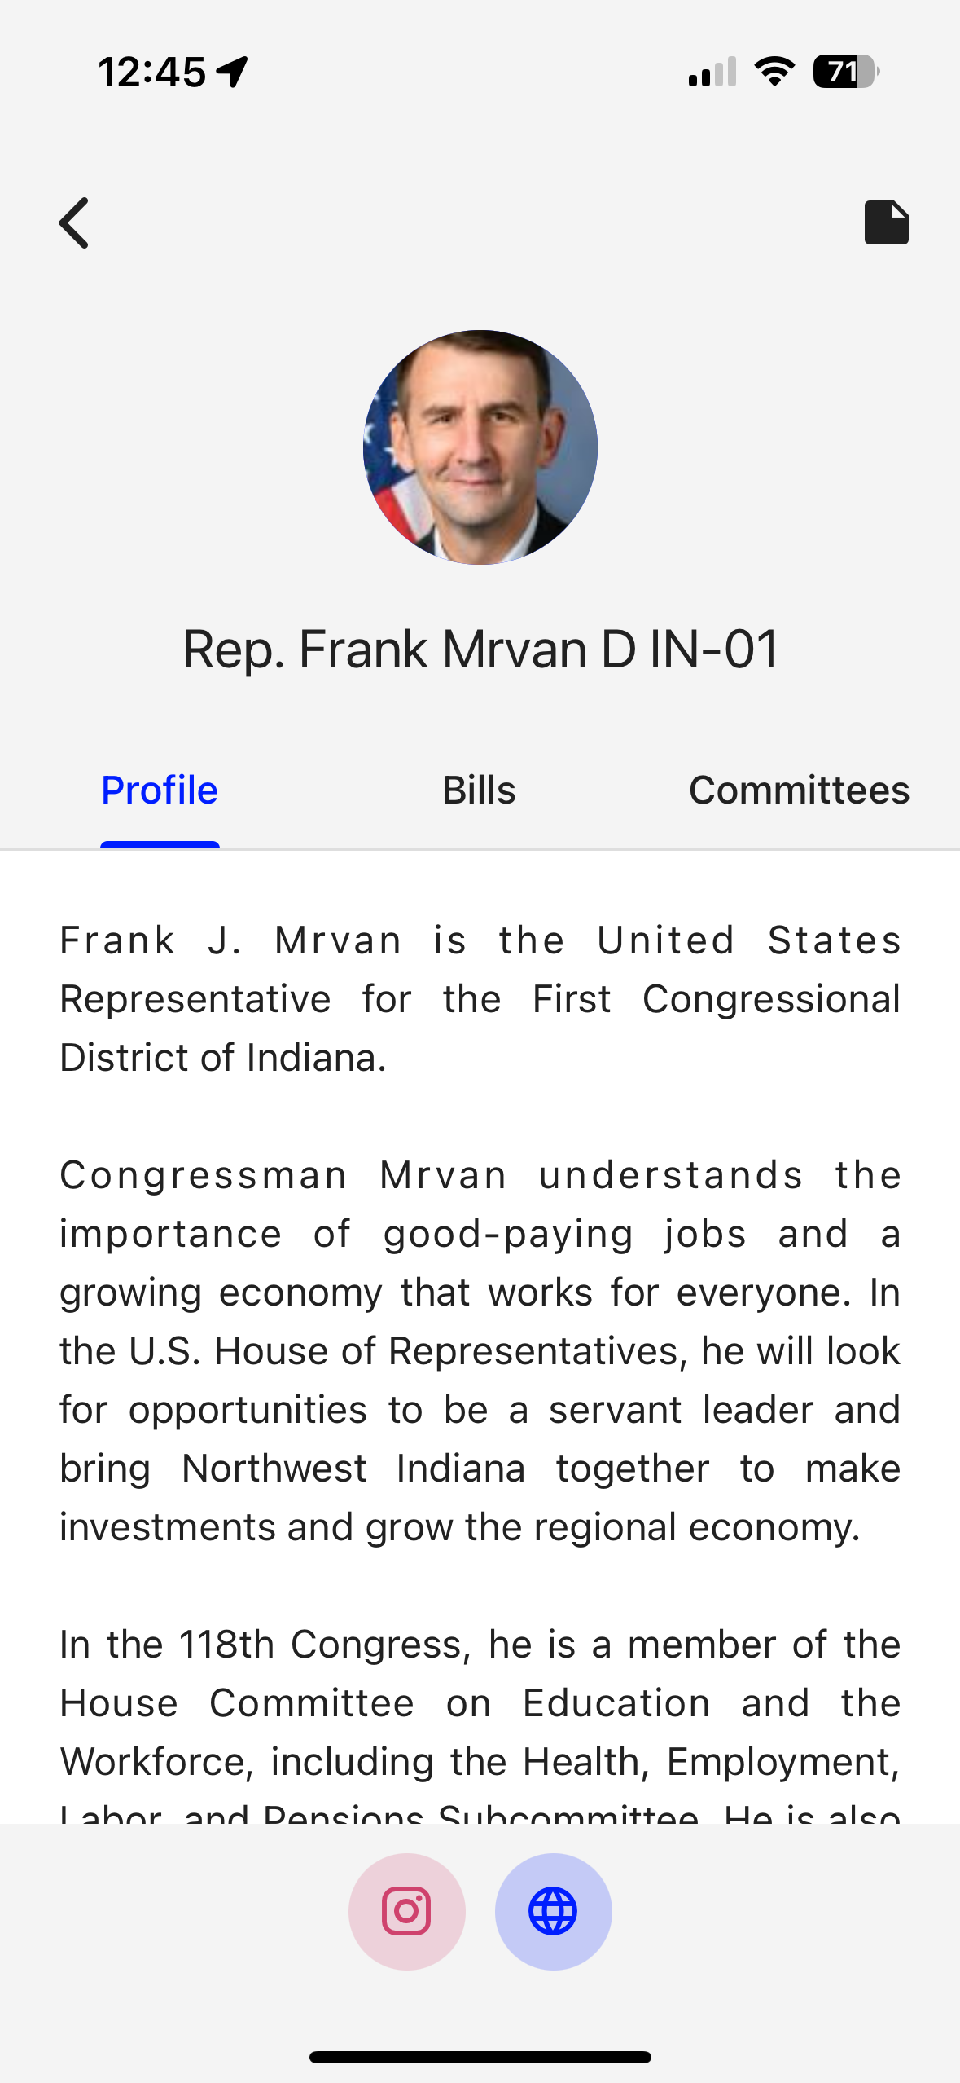
Legislators tab, tap on each for a biography

Slide 29
Legislators tab, tap on each for a biography
Relevant bills with voting record, committee assignments

Slide 30
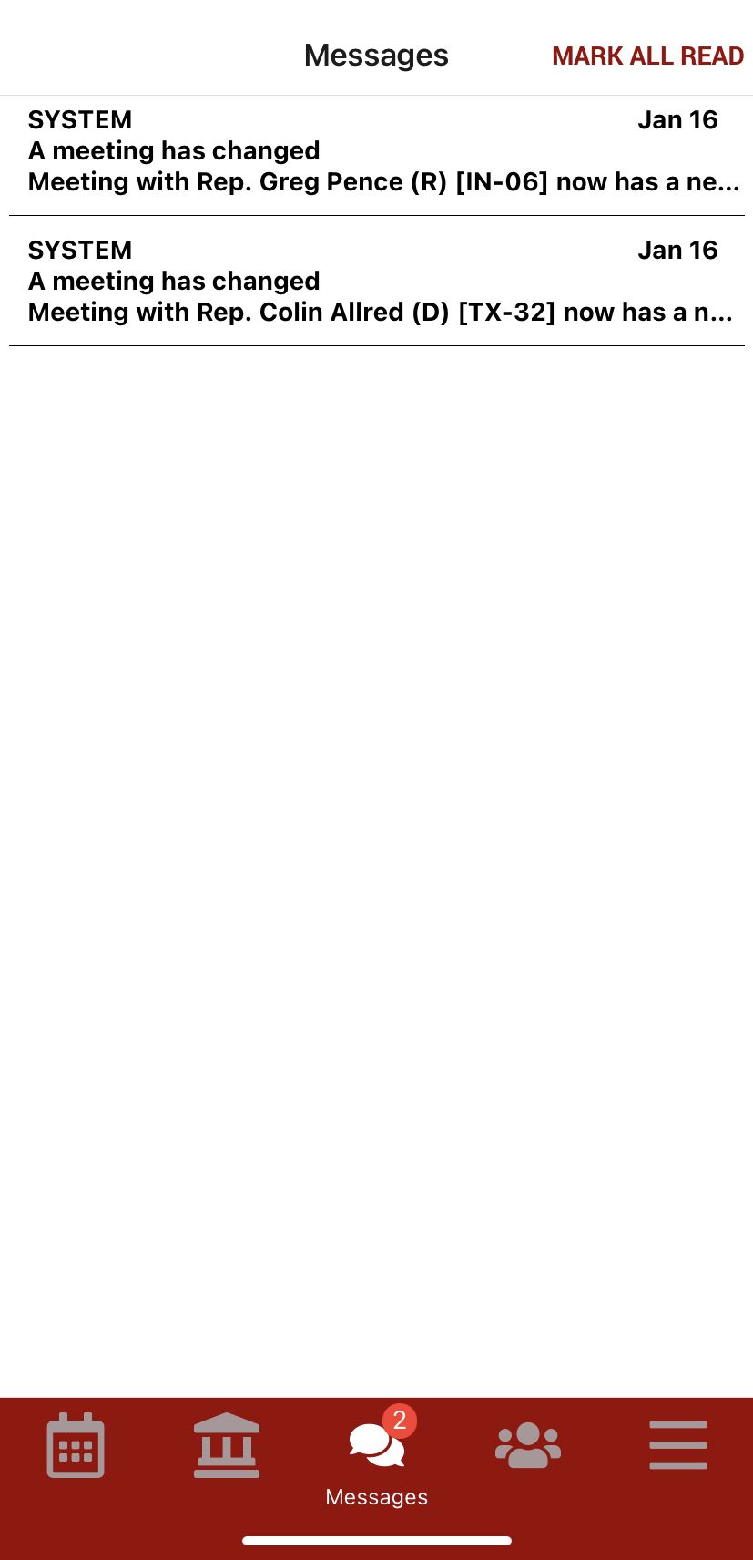
Legislators tab, tap on each for a biography
Relevant bills with voting record, committee assignments
Messages tab to highlight any updates. You will also receive updates via push notification and email

Slide 31
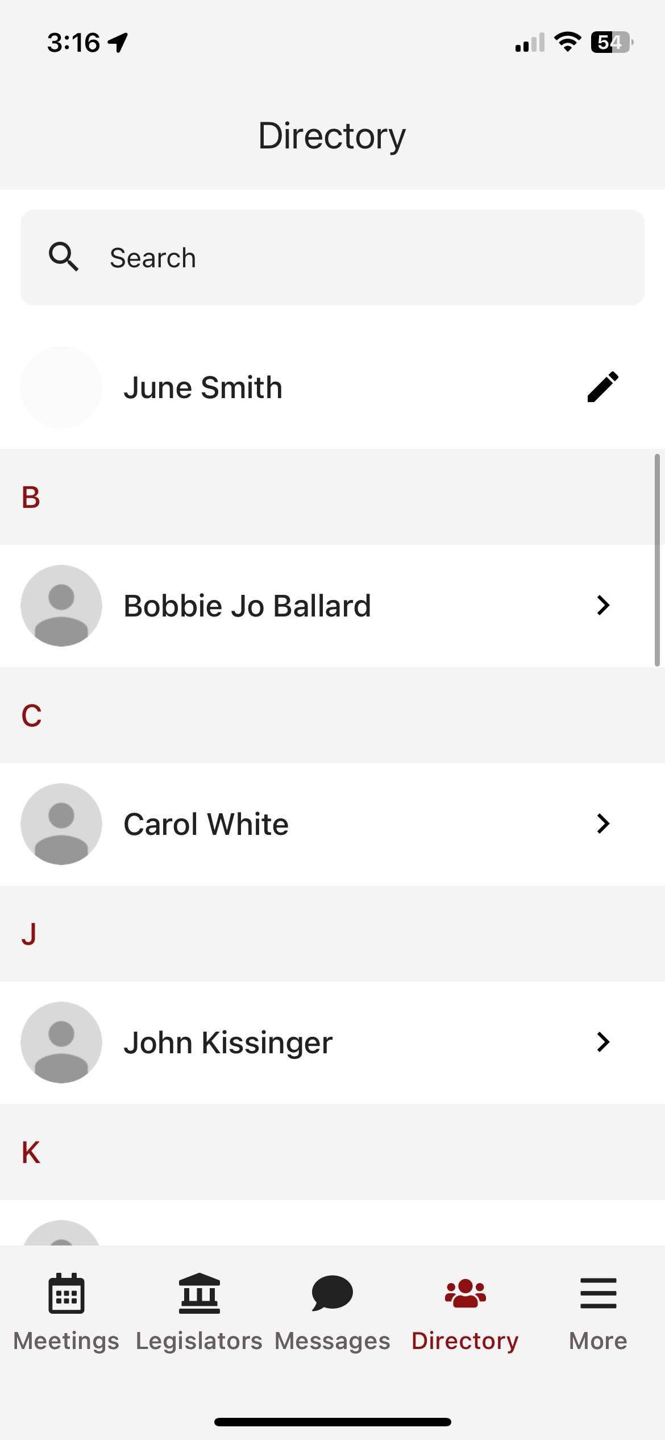
Legislators tab, tap on each for a biography
Relevant bills with voting record, committee assignments
Messages tab to highlight any updates. You will also receive updates via push notification and email
Directory to look up attendees in your event. Tap to get more information

Slide 32
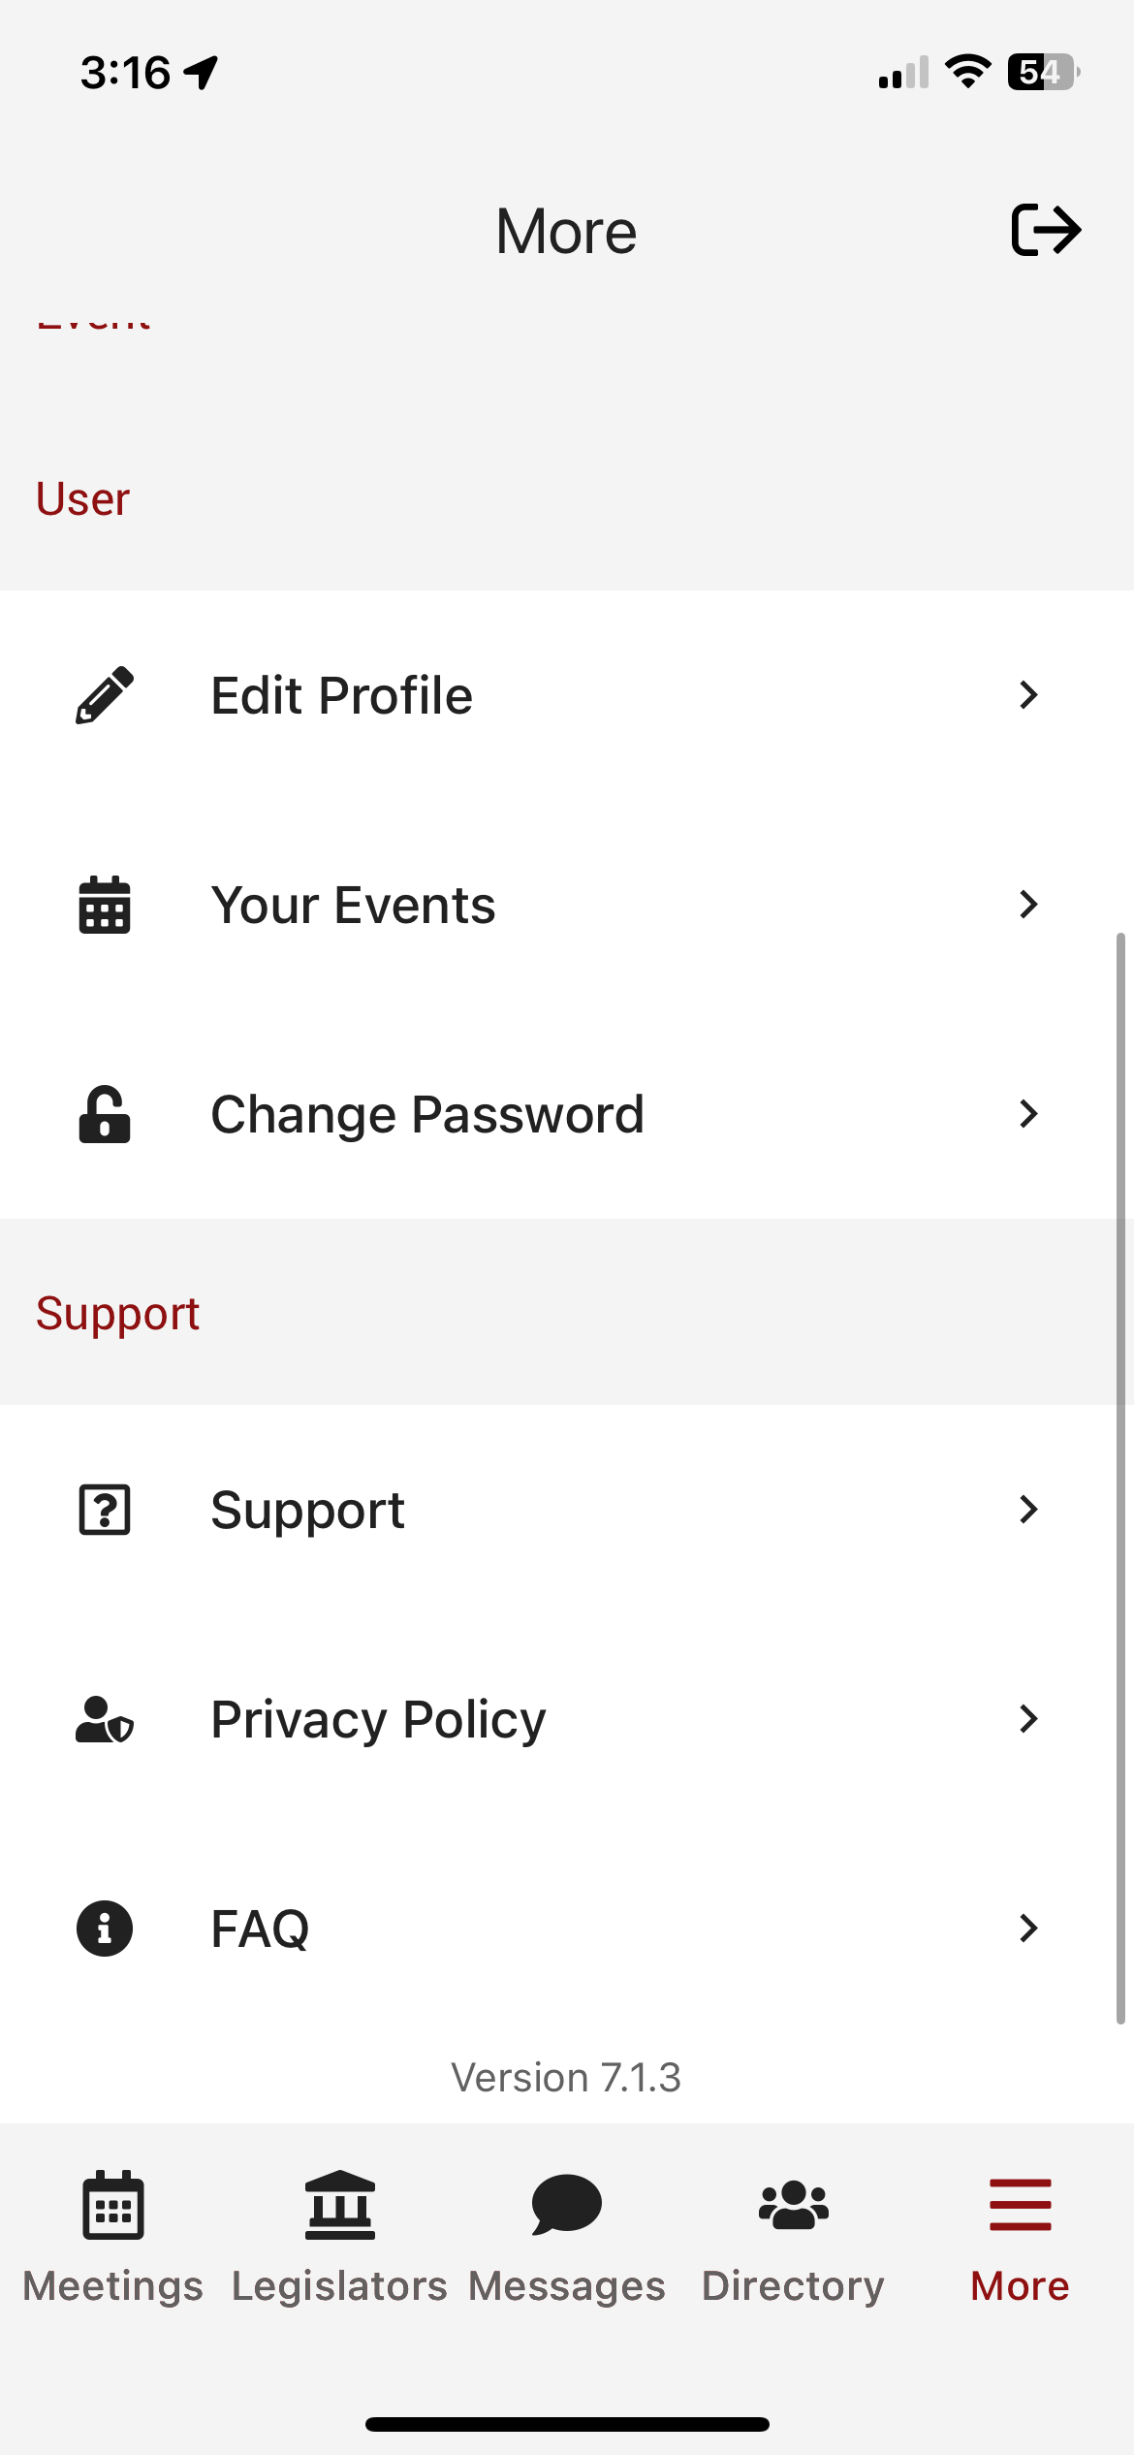
Legislators tab, tap on each for a biography
Relevant bills with voting record, committee assignments
Messages tab to highlight any updates. You will also receive updates via push notification and email
Directory to look up attendees in your event. Tap to get more information
More tab for additional resources, importantly all SUPPORT and FAQs

Slide 33
Relevant Information and Reminders
Check your SPAM/JUNK folder to ensure you didn’t miss the initial email (domain is @advocacyassociates.com)
Give yourself 30 minutes to get through security and navigate your way to the office
All times will be displayed in the time zone you are in
There will be a help number listed in the Support tab to call if you need to get ahold of Advocacy Associates
Meetings may last anywhere from 15-30 minutes, prepare your pitch and talking points accordingly. ASK how much time the office has
Any changes to your schedule the day of the event will be sent to you via push notification and email. Please be sure to check regularly throughout the day. Updates will also be flagged in the Messages tab in your app

Slide 34
App Schedules and Logistics Overview

